Slide 1
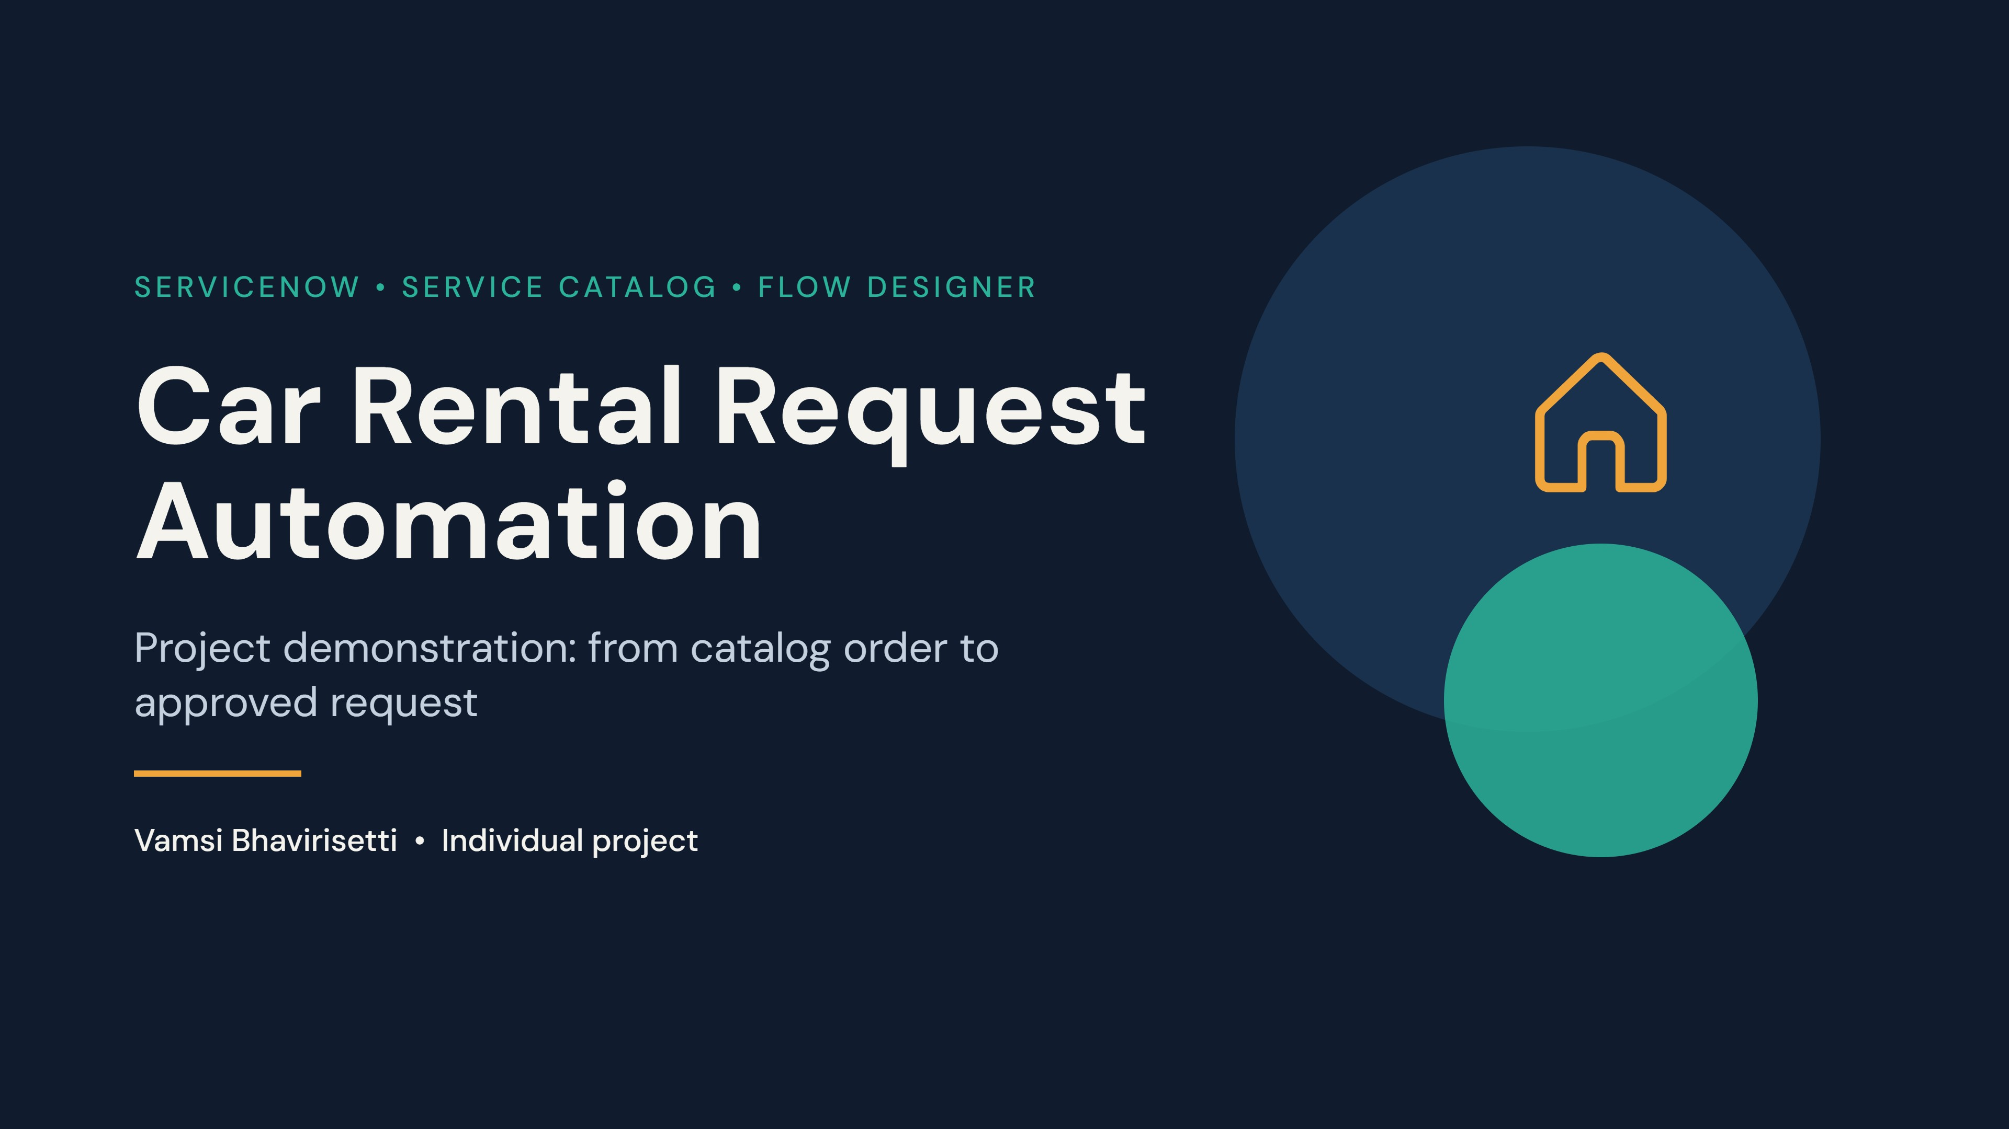
Notes:
Introduce yourself and the project. Say: this demo shows how an employee orders a rental car in ServiceNow and how the approval, task assignment and email happen automatically. About 8 minutes: problem, solution, live walkthrough, business rule, test results.

Slide 2
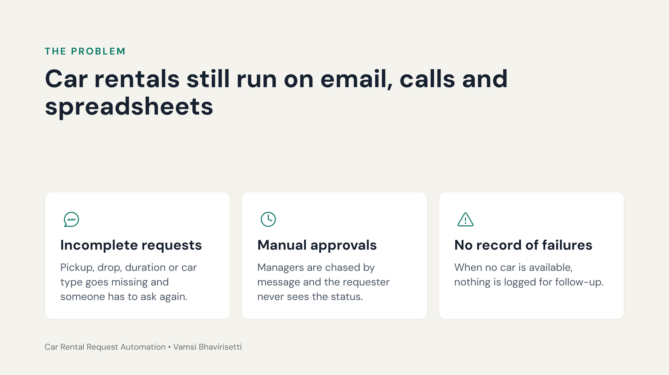
Notes:
Explain the problem in one minute. Employees ask for cars by email or phone, details are missing, approvals are chased by hand, and when a car is not available there is no formal record. The project replaces this with one structured process inside ServiceNow.

Slide 3
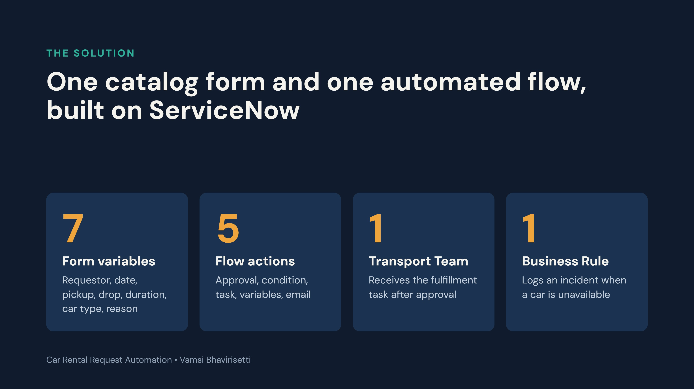
Notes:
The solution is entirely ServiceNow native: a Service Catalog item with seven variables, a Flow Designer flow with five actions, a Transport Team group that gets the task, and one Business Rule. No separate application or database is used.

Slide 4
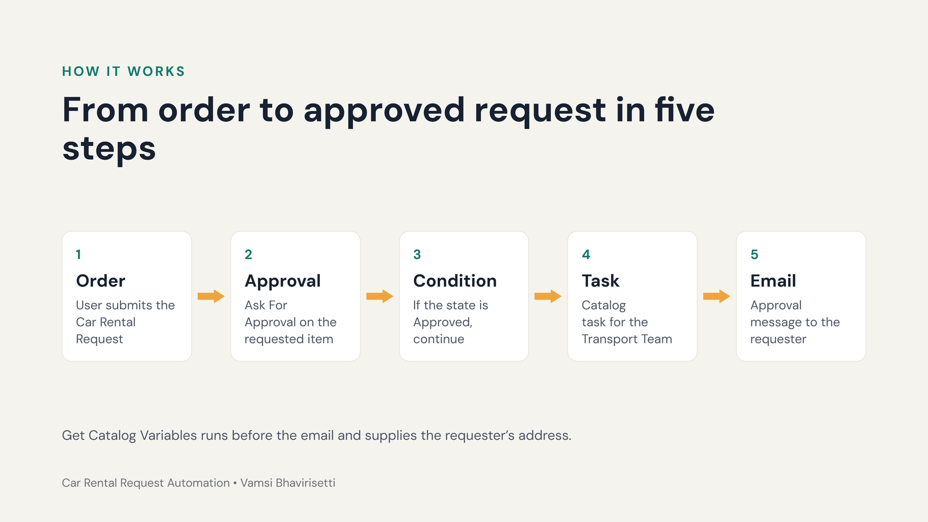
Notes:
Walk through the five steps. 1: the user orders the catalog item. 2: the flow asks for approval. 3: an If condition checks that the approval state is Approved. 4: a catalog task is created for the Transport Team. 5: the flow reads the catalog variables and sends the approval email. Next, show each step live.

Slide 5
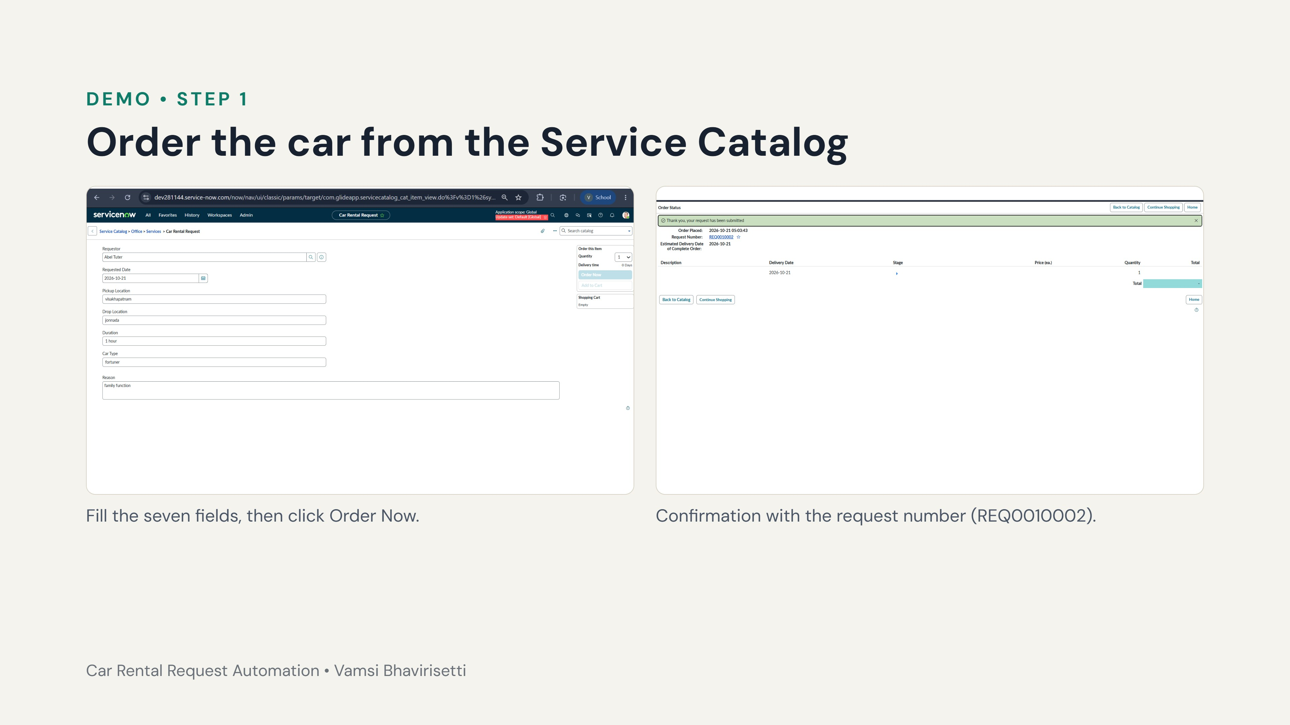
Notes:
Demo step 1. Open the Car Rental Request item in the Service Catalog (Try It). Enter the requestor, requested date, pickup location, drop location, duration, car type and reason. In our test: pickup Visakhapatnam, drop Jonnada, duration 1 hour, car type Fortuner, reason family function. Click Order Now. ServiceNow confirms the submission and shows the request number.

Slide 6
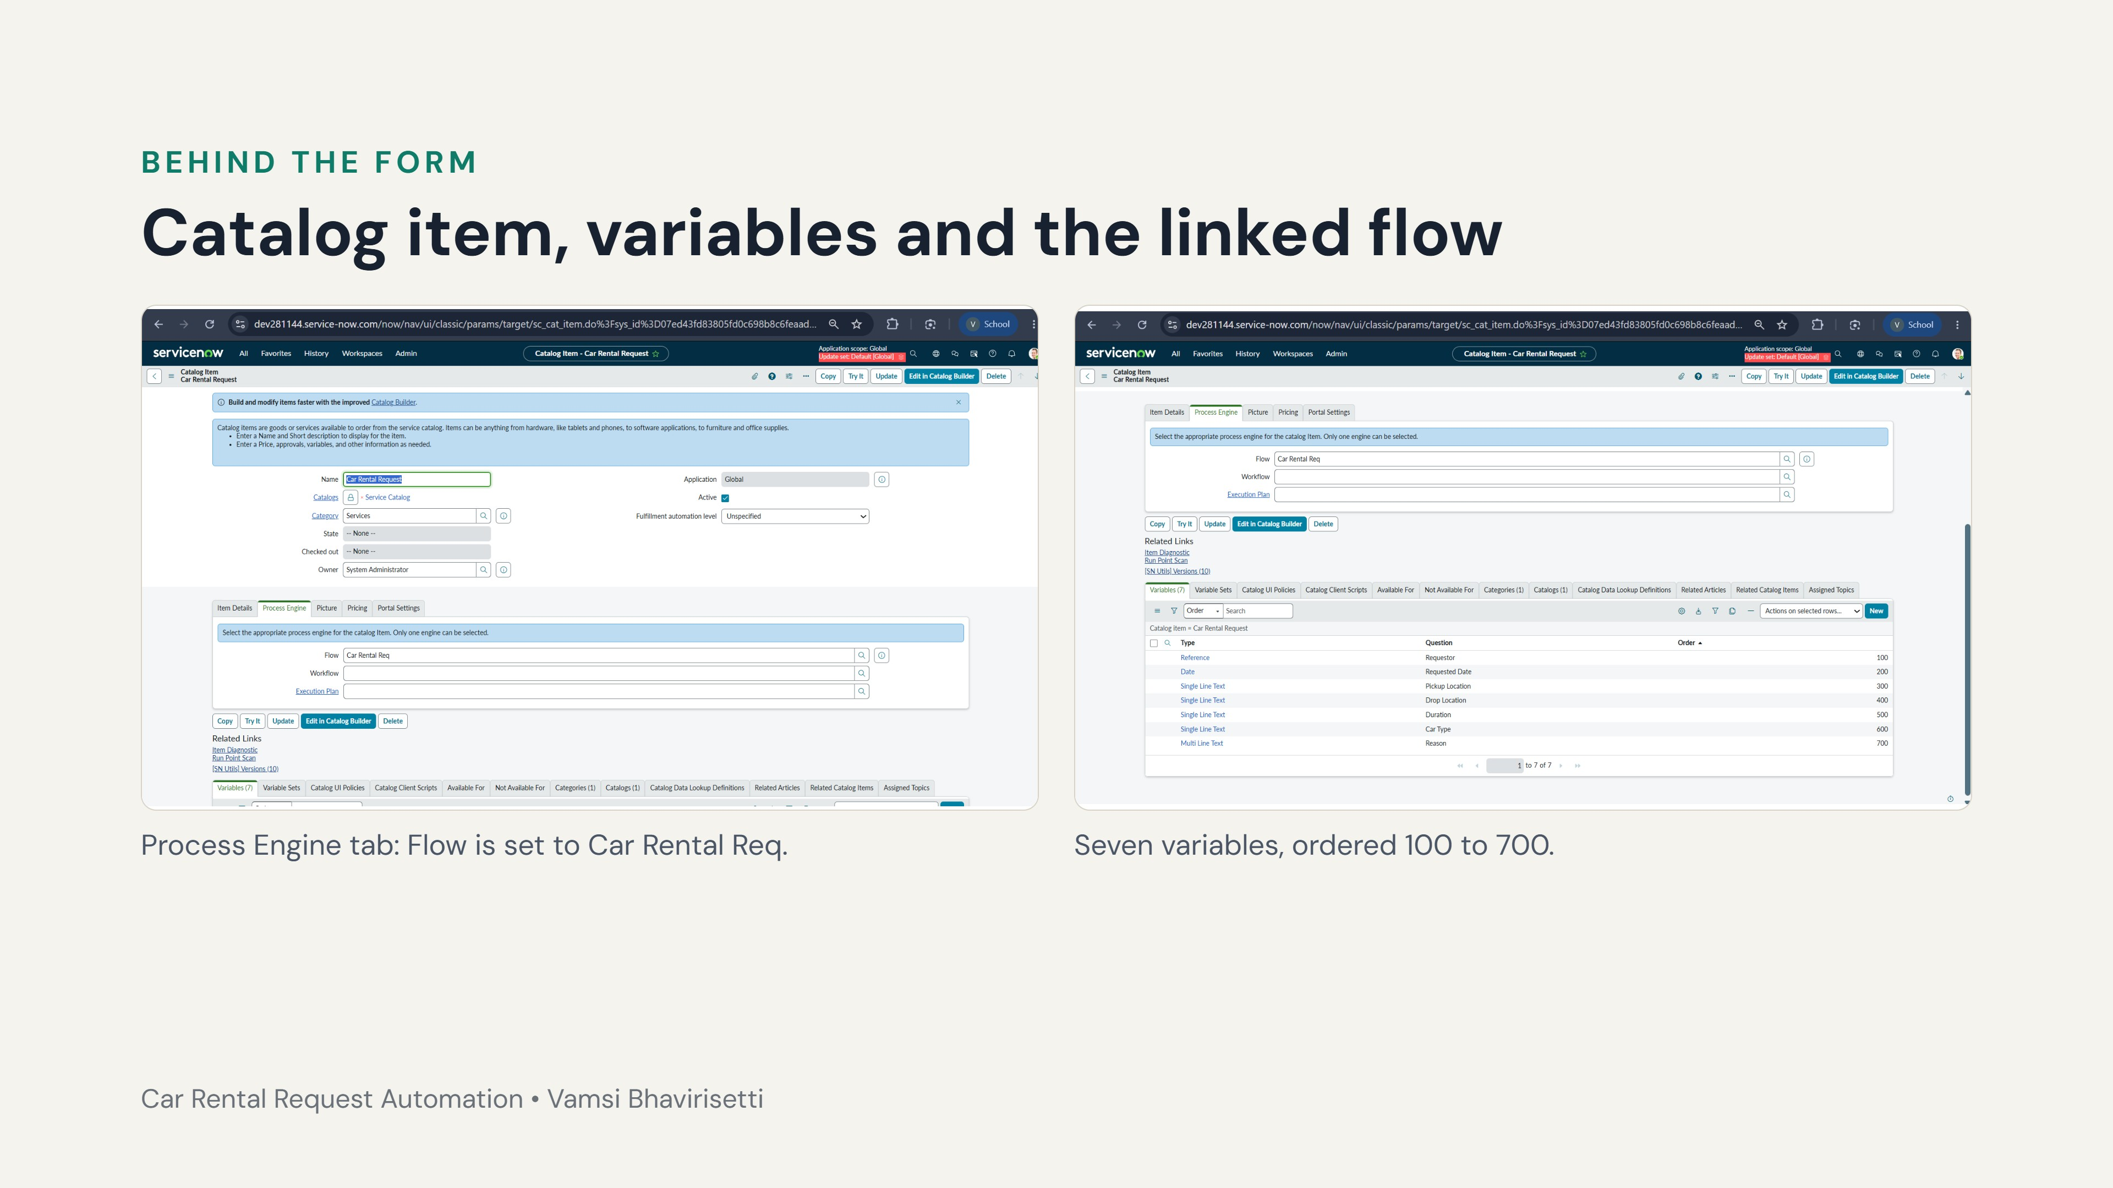
Notes:
Show the catalog item record. On the Process Engine tab the Flow field points to Car Rental Req, so every order starts the flow. In the Variables list: Requestor (reference to user), Requested Date, Pickup Location, Drop Location, Duration, Car Type and Reason (multi-line text).

Slide 7
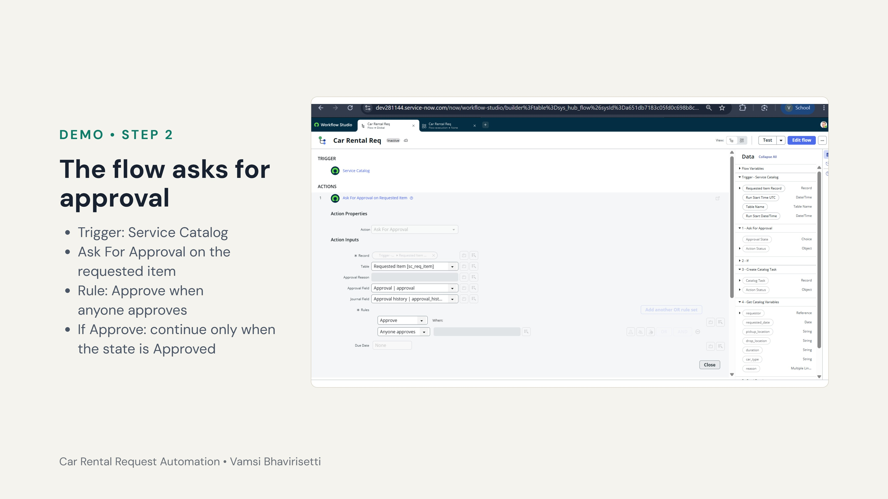
Notes:
Open the Car Rental Req flow. The trigger is Service Catalog. Action 1 is Ask For Approval: record is the requested item, table sc_req_item, approval field Approval, journal field Approval history, rule Approve when anyone approves. Action 2 is an If condition labelled If Approve that checks the approval state is Approved. Everything after it runs only after approval.

Slide 8
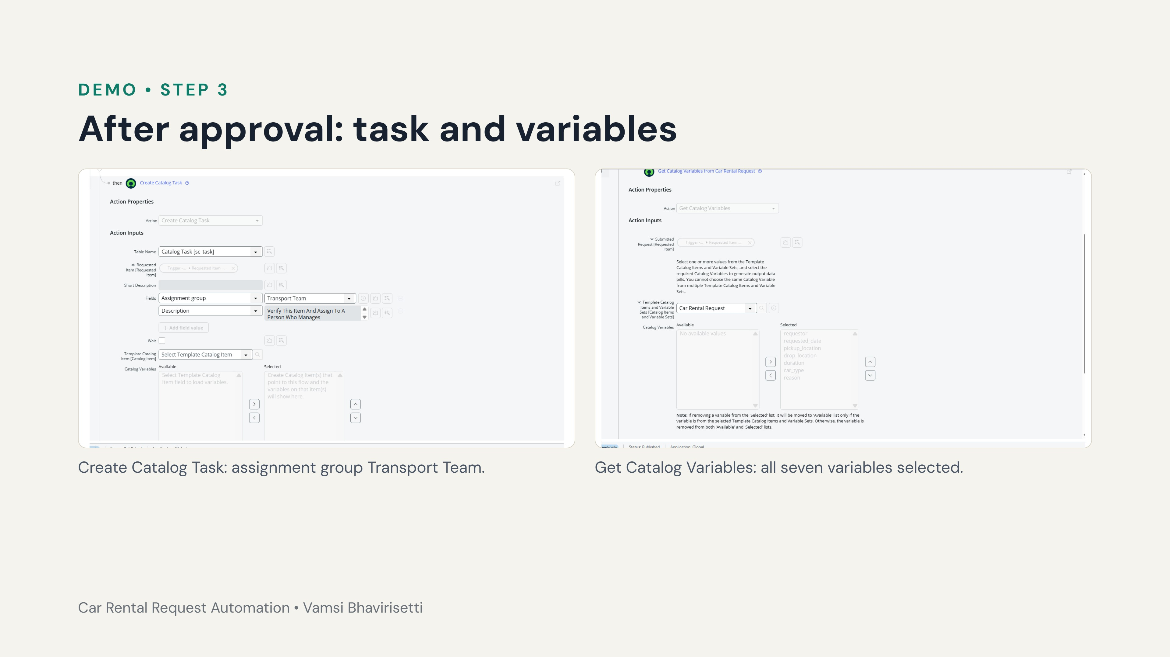
Notes:
Inside the then branch, action 3 creates a catalog task in sc_task with assignment group Transport Team and the description Verify This Item And Assign To A Person Who Manages. Action 4 gets the catalog variables from Car Rental Request: requestor, requested date, pickup, drop, duration, car type and reason, so the next action can use the requester’s email.

Slide 9
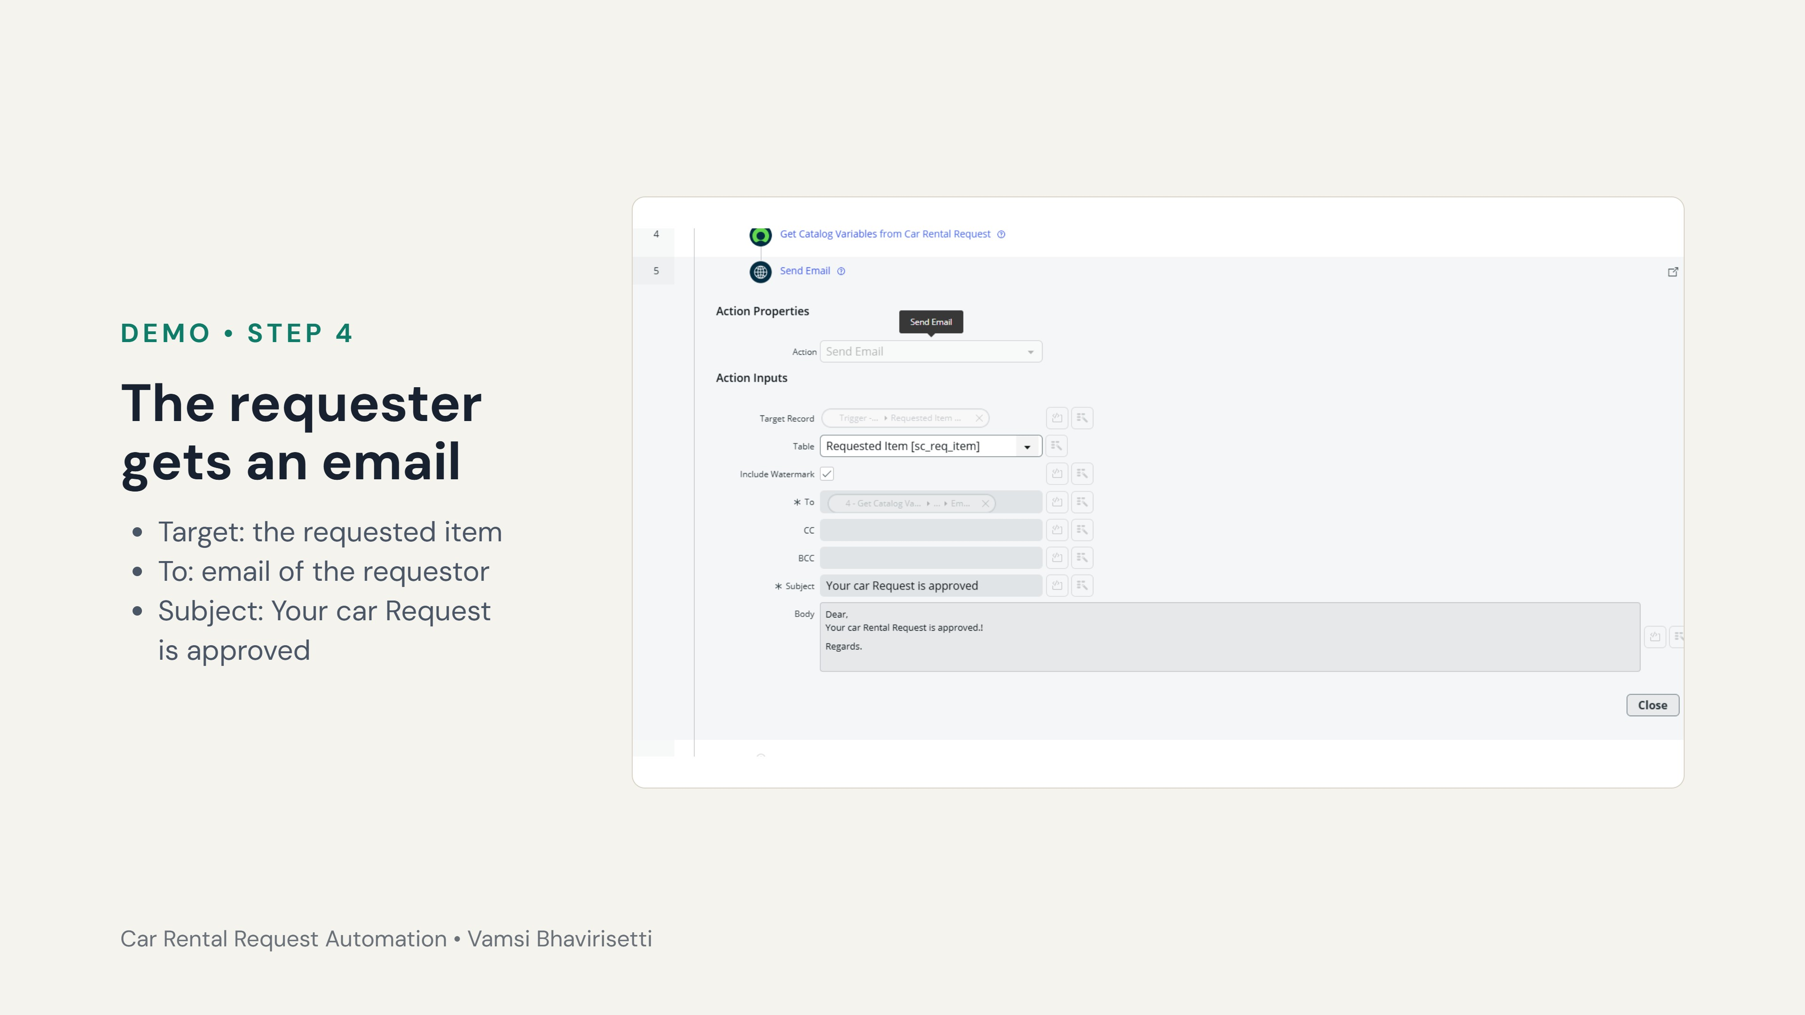
Notes:
Action 5 is Send Email. The To field uses the email of the requestor taken from the Get Catalog Variables step. The subject is Your car Request is approved and the body says that the car rental request is approved. In the flow execution, this action shows Completed.

Slide 10
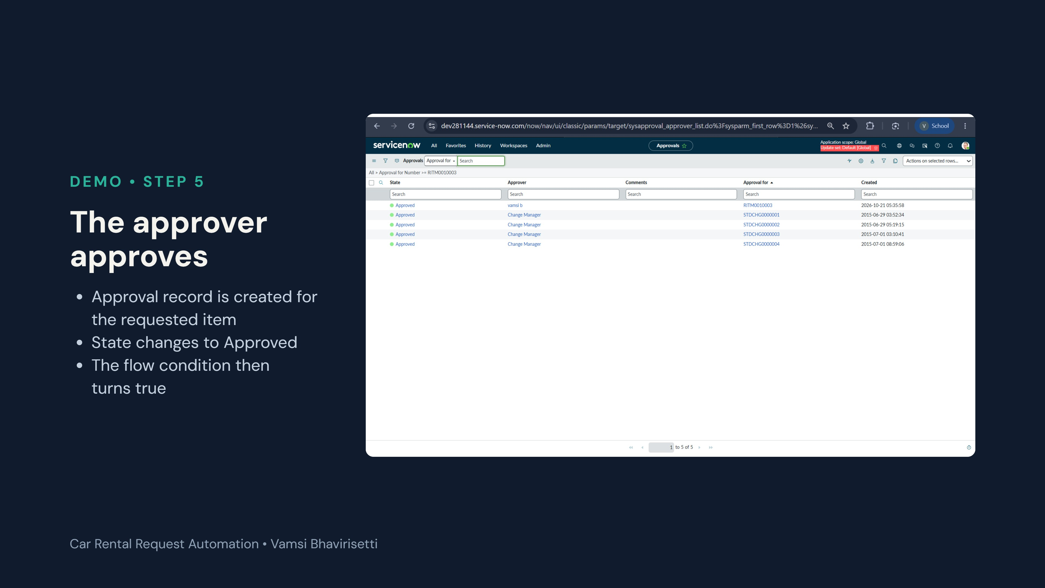
Notes:
Open the Approvals list (or the Approvers tab on the requested item) and approve the request. The screenshot shows the approval for RITM0010003 in the Approved state, approved by the approver account with the date and time recorded. Once approved, the flow continues.

Slide 11
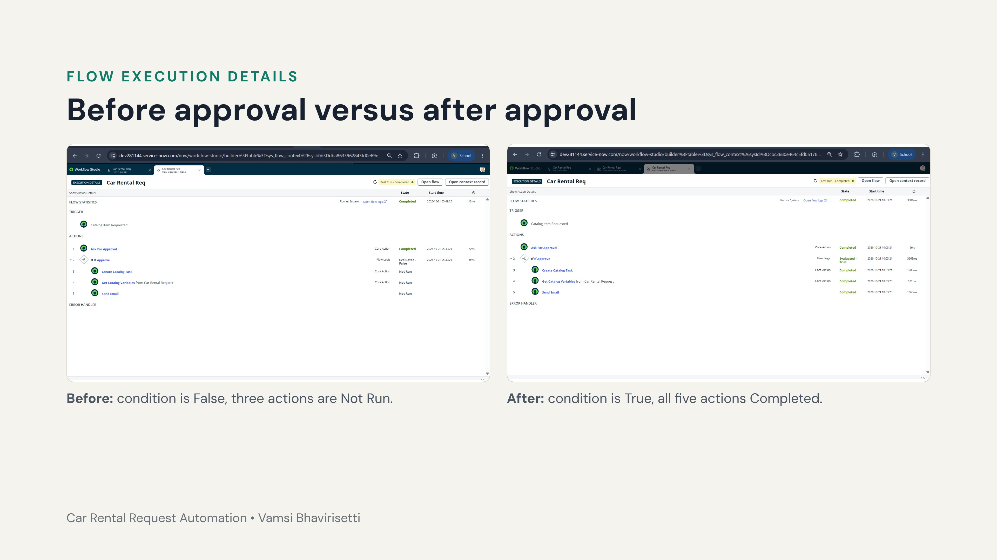
Notes:
Use Test in Flow Designer and open the execution details. Left: the test ran before the approval was granted. Ask For Approval completed, the If condition was evaluated as False, so Create Catalog Task, Get Catalog Variables and Send Email were Not Run. Right: after approval the If condition was evaluated as True and all five actions show Completed. This proves the approval gate works.

Slide 12
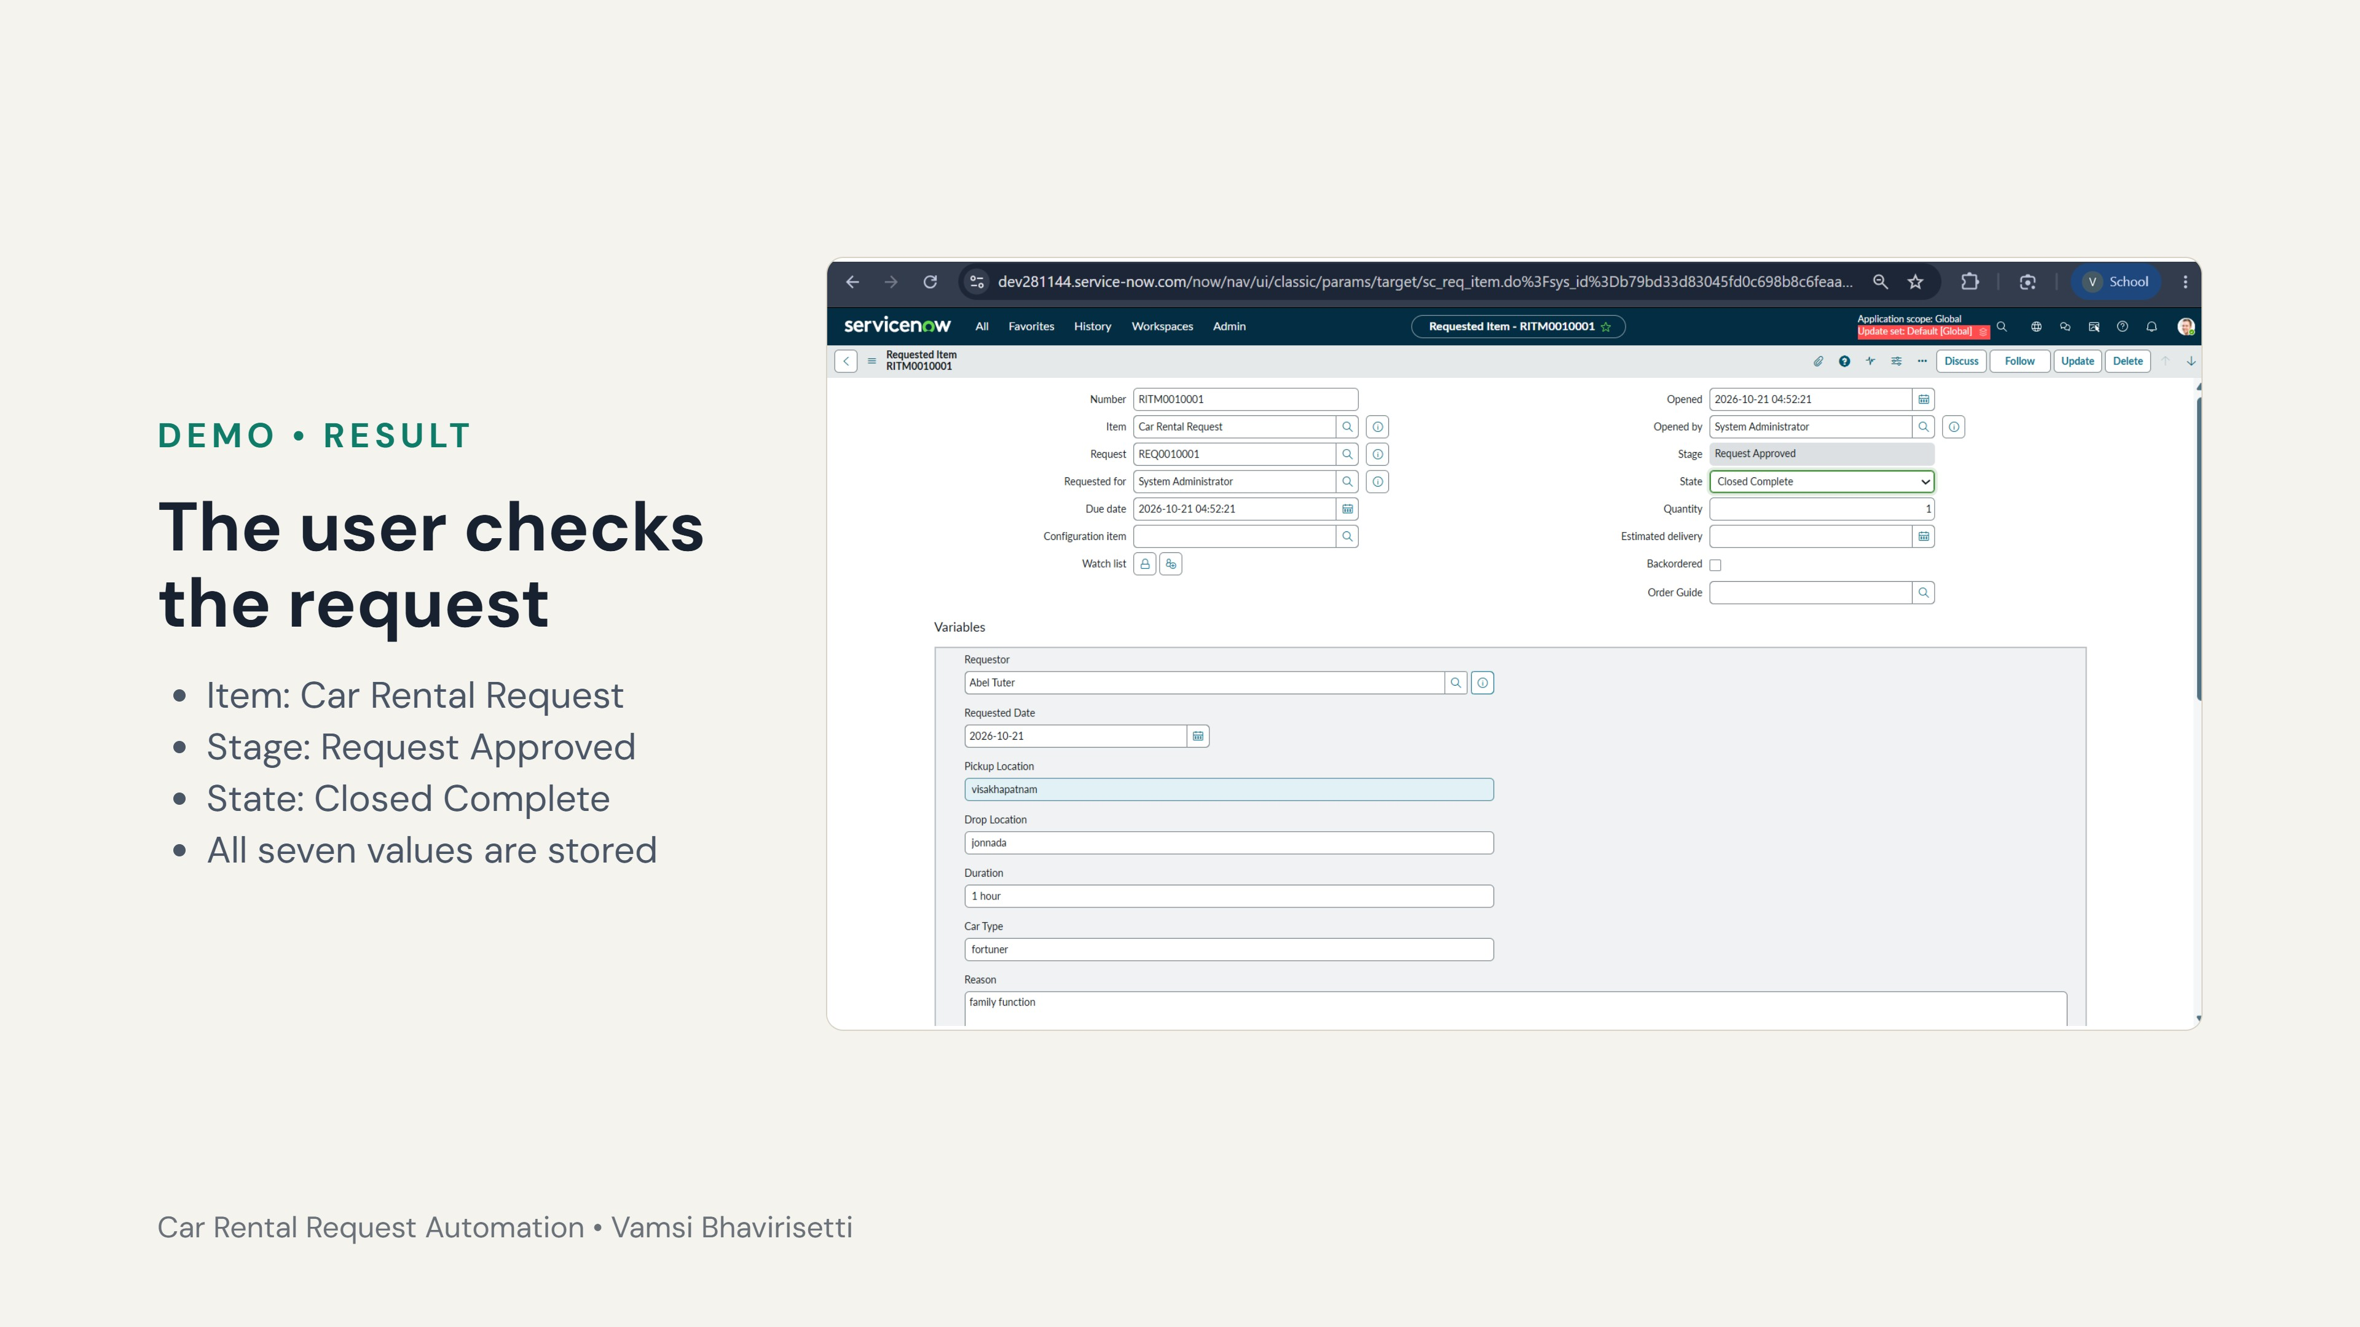
Notes:
Open the requested item RITM0010001 to show the final status. Stage is Request Approved and State is Closed Complete. The variables section keeps what the user entered: requestor Abel Tuter, requested date 2026-10-21, pickup Visakhapatnam, drop Jonnada, duration 1 hour, car type Fortuner and reason family function.

Slide 13
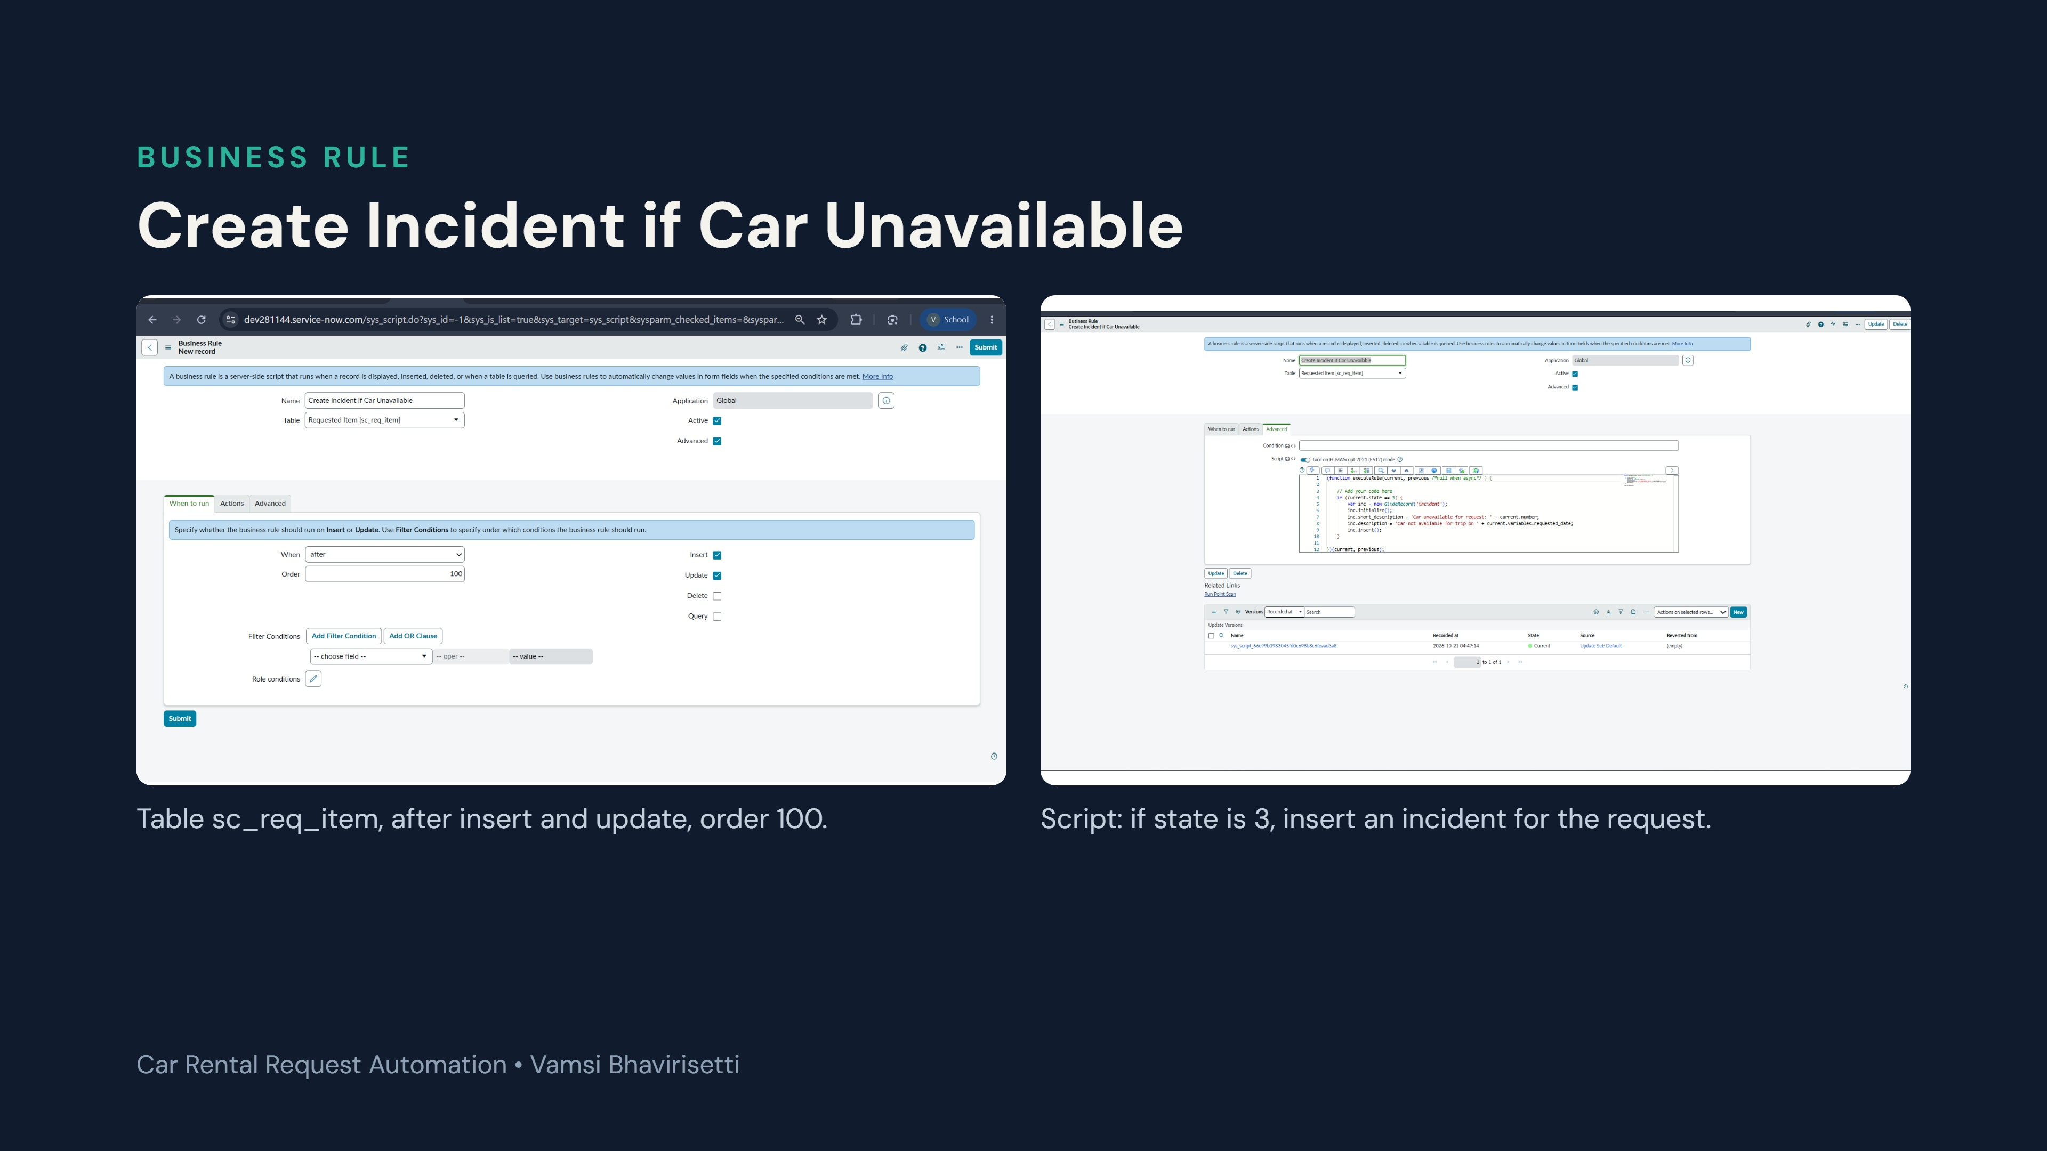
Notes:
Show the Business Rule. It is active on Requested Item, runs after insert and update with order 100, and is Advanced. The script checks current.state == 3, then creates an incident with short description Car unavailable for request plus the RITM number, and a description that gives the requested date from the catalog variable. The rule is saved in the Default update set.

Slide 14
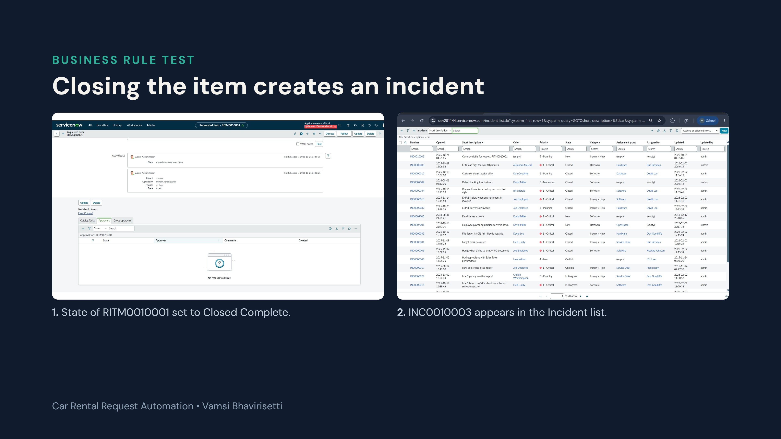
Notes:
Test of the Business Rule. Left: the activity log shows the state of RITM0010001 changed from Open to Closed Complete. Right: searching the incident list for car shows INC0010003, Car unavailable for request: RITM0010001, state New, created at the same time. This confirms the rule works. Mention the limit: state 3 is also the normal successful close, so production should use a dedicated condition.

Slide 15
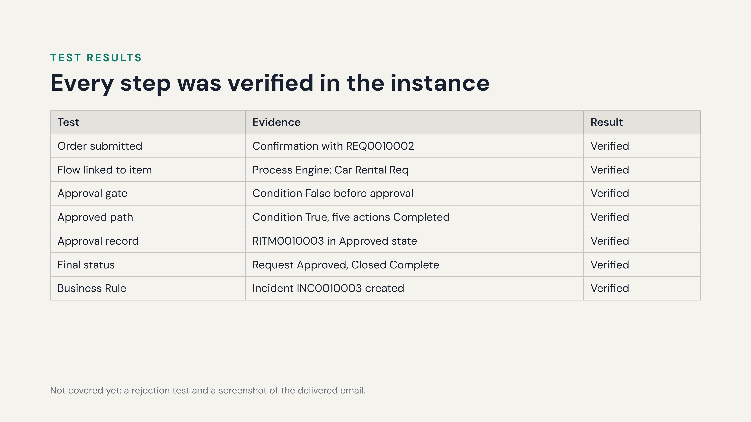
Notes:
Summarize the evidence. Each row corresponds to a screenshot in the demo. Be upfront about what is not covered: there is no rejection test and no screenshot of the delivered email yet.

Slide 16
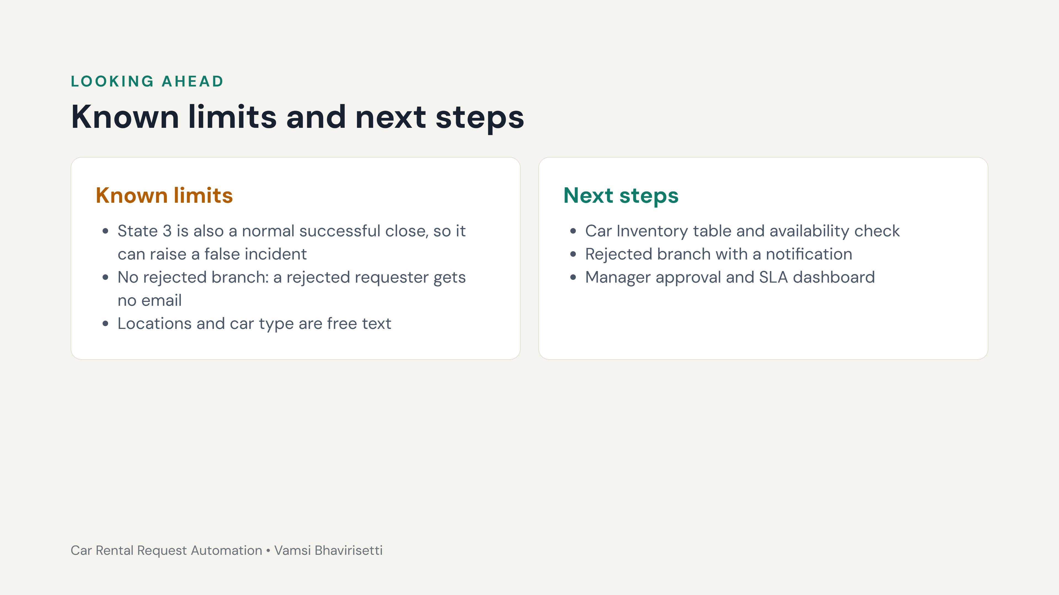
Notes:
Be honest about the limits. The Business Rule uses state 3, which is also the normal success state, so a production version should use a dedicated condition such as Closed Incomplete or a field that marks unavailability. The flow has no rejected branch. Fields are free text. Next steps: a Car Inventory table with an availability check, a rejected branch with notification, manager-based approval, and an SLA dashboard.

Slide 17
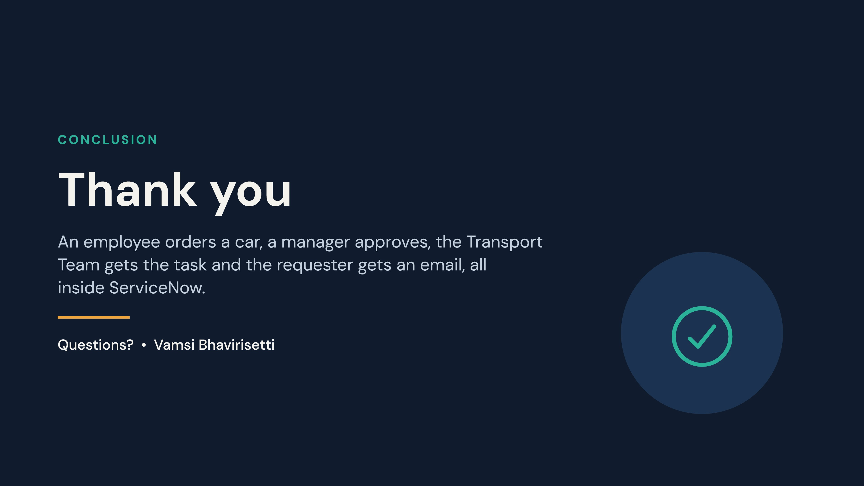
Notes:
Close with the one-sentence summary and invite questions.

